Slide 1

TIC AND TECHNOLOGIES
Projet par :
Guiz Mehdi Amine
Khennouf Hamza
Laifaoui Abdellah
Billal Belakab
Zakaria Aiouaze

Slide 2
Content table
Introduction to Information and Communication Technologies (TIC)
Google Services
Microsoft Tools
Git and GitHub
Integrating TIC Tools for Collaborative Work
Case Studies: Successful Implementations
Challenges and Solutions in TIC Adoption
Future Trends in TIC

Slide 3

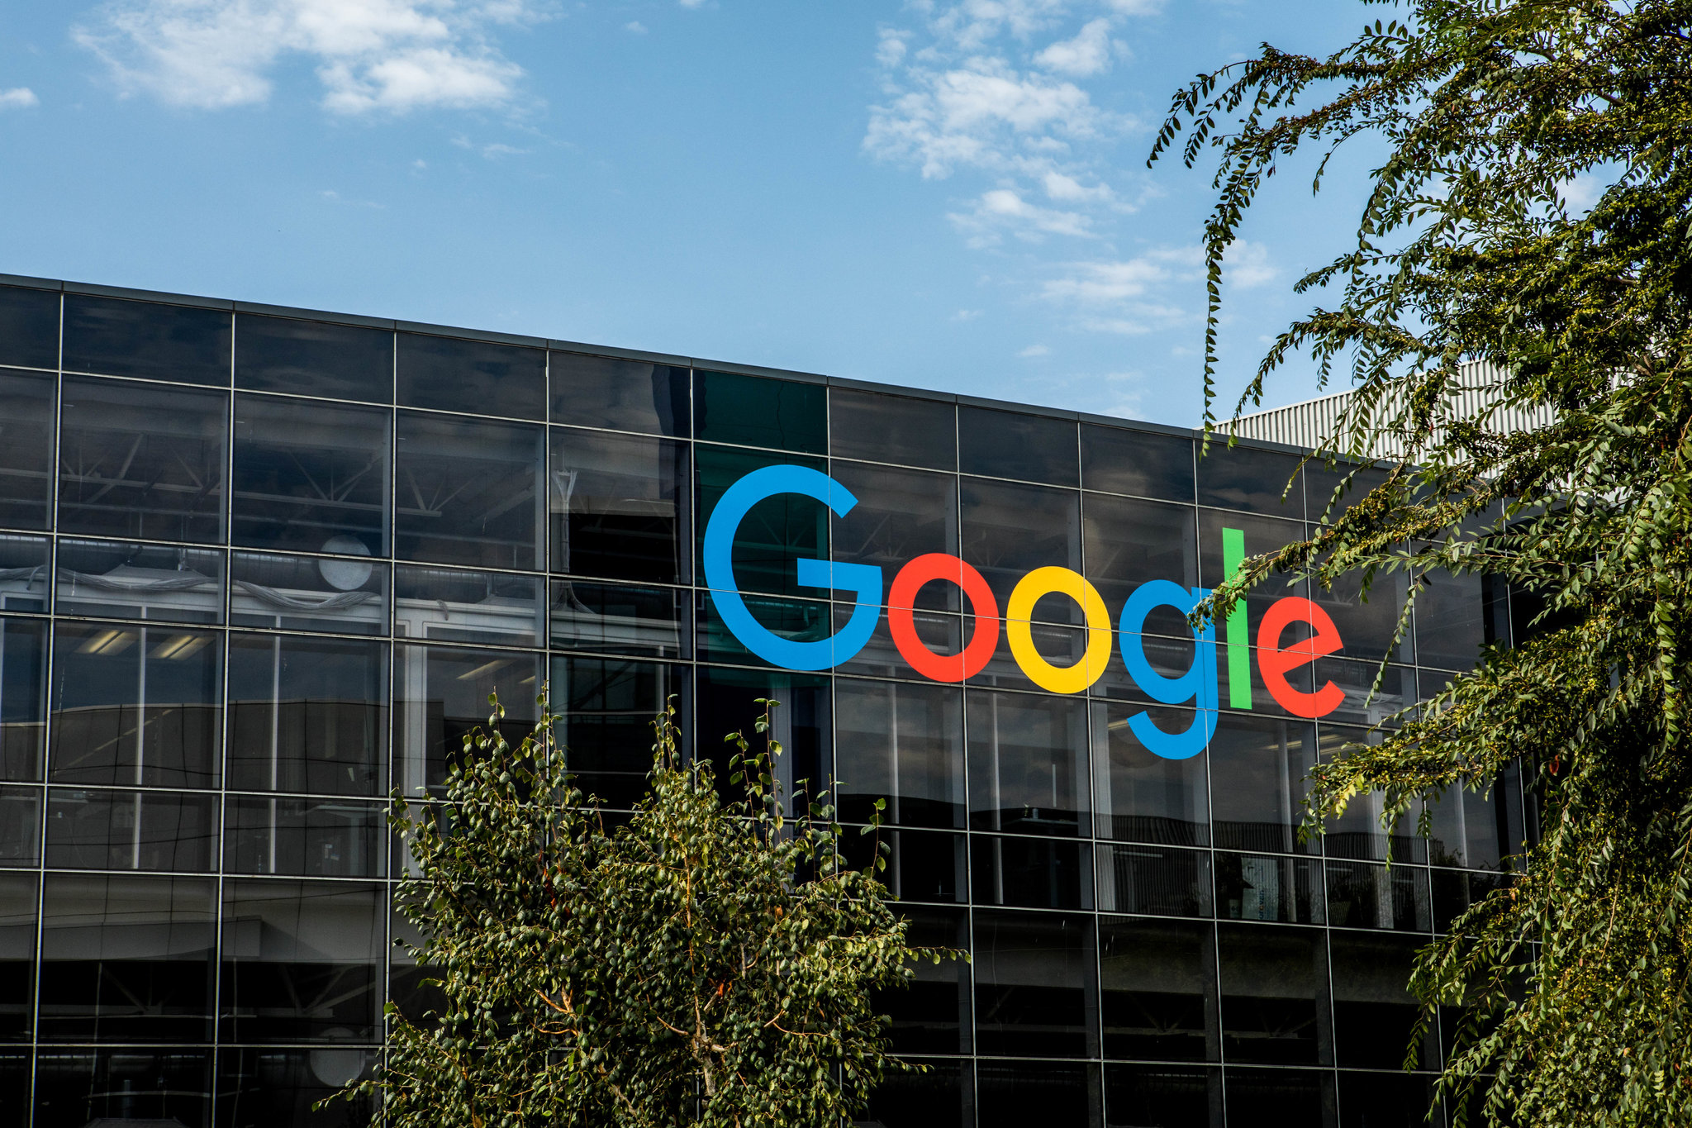
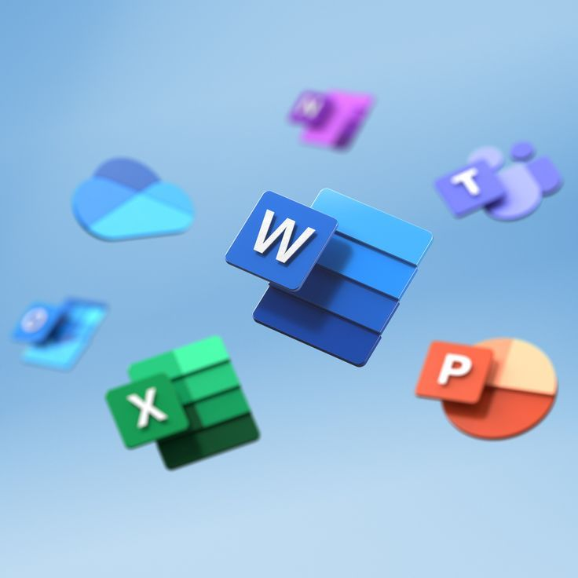



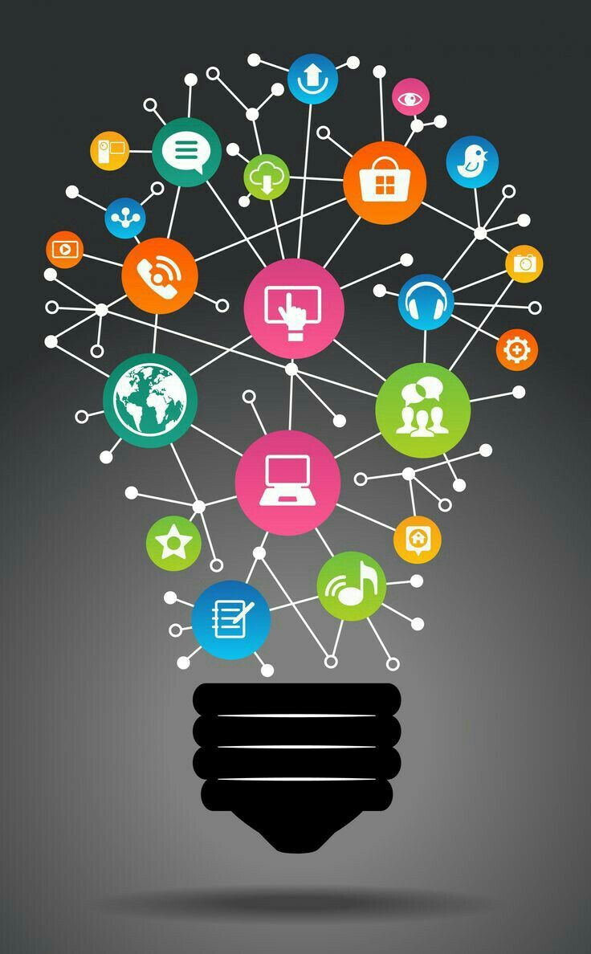
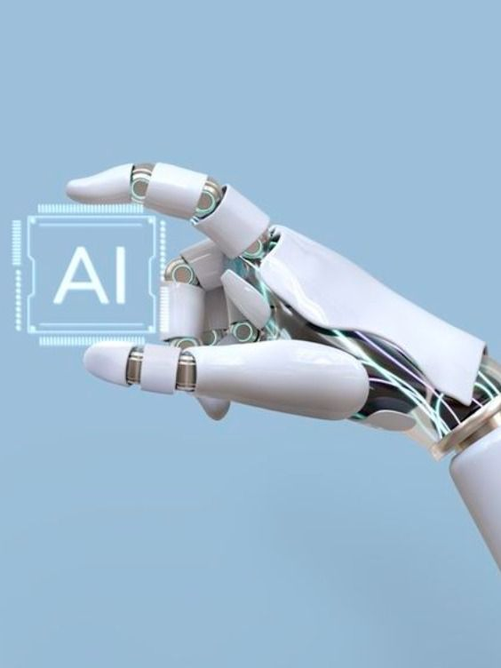
TIC :
Information and Communication Technologies (TIC) encompass a vast array of tools and technologies transforming the way we connect, communicate, and collaborate in today's digital age. From fundamental elements like email services, cloud storage, and productivity suites such as Google services and Microsoft tools to advanced version control systems like Git and collaborative platforms like GitHub, these technologies serve as the backbone of our interconnected world. TIC tools enable real-time communication, seamless data sharing, efficient project management, and innovative solutions, revolutionizing how we work, learn, and interact in the digital realm.
Google Services
Microsoft Tools
TIC

Slide 4
GOOGLE SERVICES :
Google Services represent a comprehensive suite of tools catering to various aspects of modern life. From the ubiquitous Google Search to the convenience of Gmail for efficient email communication, Google Drive offering cloud storage and collaborative workspaces, and Google Workspace streamlining productivity through applications like Docs, Sheets, and Slides. Additionally, Google Maps facilitates seamless navigation, while Google Photos simplifies photo and video management. These services, deeply integrated and easily accessible across devices, exemplify Google's commitment to innovation, connectivity, and user convenience in today's digital landscape.
Canada
Japan
Indonesia
Malaysia
Japan
Indonesia
Malaysia
Microsoft Tools
Google Services
About country here
About country here
About country here
About country here
About country here
About country here
About country here

Slide 5
MICROSOFT TOOLS :
Microsoft Tools encompass a versatile suite designed to empower individuals and organizations in various spheres. The acclaimed Microsoft Office Suite, including Word, Excel, PowerPoint, and Outlook, remains integral for document creation, data analysis, and communication. Microsoft Teams serves as a robust collaboration platform, facilitating seamless teamwork through chat, video conferencing, and document sharing. Furthermore, SharePoint offers comprehensive content management, while OneDrive provides secure cloud storage and access. With an ecosystem that extends from development tools like Visual Studio to business analytics via Power BI, Microsoft continues to offer a diverse array of solutions, fostering innovation, productivity, and efficiency in the digital realm.
Integrating TIC Tools for Collaborative Work
Japan
Indonesia
Malaysia
Dubai
Indonesia
Malaysia
Dubai
Microsoft Tools
About country here
About country here
About country here
About country here
About country here
About country here
About country here

Slide 6
GIT & GITHUB :
"Git and GitHub revolutionize collaborative software development. Git, a distributed version control system, empowers developers to track changes, manage versions, and work on code collaboratively across teams. GitHub, a collaborative platform built around Git, provides a centralized hub for code hosting, facilitating seamless collaboration through features like pull requests, code reviews, and issue tracking. Together, Git and GitHub streamline development workflows, enabling efficient code management, version control, and fostering a community-driven approach to software development.
Integrating TIC Tools for Collaborative Work
Case Studies: Successful Implementations
Indonesia
Malaysia
Dubai
Canada
Malaysia
Dubai
Canada
About country here
About country here
About country here
About country here
About country here
About country here
About country here

Slide 7
Integrating TIC Tools for Collaborative Work
Integrating TIC Tools for Collaborative Work
Case Studies: Successful Implementations
Challenges and Solutions in TIC Adoption
Integrating Information and Communication Technologies (ICT) tools is fundamental for seamless collaborative work environments. These tools, encompassing platforms like Microsoft Teams, Google Workspace, Slack, and project management tools such as Trello or Asana, facilitate real-time communication, document sharing, and task management. Establishing these collaborative ecosystems enables teams to transcend geographical boundaries, fostering efficient workflows and enhancing productivity. Whether for remote teams or in-office collaborations, the effective integration of ICT tools lays the foundation for streamlined communication, agile project management, and successful teamwork.
Malaysia
Dubai
Canada
Japan
Malaysia
Dubai
Canada
About country here
About country here
About country here
About country here
About country here
About country here
About country here

Slide 8
Case Studies Successful Implementations :
Case studies showcasing successful implementations of ICT tools exemplify their transformative impact. From leveraging Microsoft Teams to unify global teams, enhancing communication, to utilizing Git and GitHub for streamlined code collaboration, these real-world examples highlight the power of technology in optimizing workflows. These success stories serve as guiding beacons, demonstrating how integrating advanced tools fosters efficient teamwork, drives productivity, and facilitates effective project management.
Case Studies: Successful Implementations
Challenges and Solutions in TIC Adoption
Future Trends in TIC
Malaysia
Dubai
Canada
Japan
Malaysia
Dubai
Canada
About country here
About country here
About country here
About country here
About country here
About country here
About country here

Slide 9
Challenges and Solutions in TIC Adoption
Future Trends in TIC
TIC
Challenges in TIC adoption, ranging from resistance to change to integration complexities, necessitate strategic solutions. Overcoming these hurdles involves implementing comprehensive training programs to address user resistance and ensure smooth transitions. Seamless integration with existing systems through meticulous planning and phased implementation stands as a key solution. By tackling these challenges head-on, organizations pave the way for successful TIC adoption, fostering a culture of innovation, efficiency, and enhanced collaboration.
Challenges and Solutions in TIC Adoption
Malaysia
Dubai
Canada
Japan
Malaysia
Dubai
Canada
About country here
About country here
About country here
About country here
About country here
About country here
About country here

Slide 10
FUTURE TRENDS IN TIC :
Future trends in Information and Communication Technologies (TIC) are set to redefine the digital landscape. From the integration of Artificial Intelligence (AI) enhancing automation and decision-making to the widespread adoption of 5G networks revolutionizing connectivity, the technological horizon is evolving. Edge computing, cybersecurity advancements, Extended Reality (XR), blockchain, quantum computing, and sustainable ICT practices are emerging as transformative forces. These trends herald a future where innovation, connectivity, and technological advancements converge, reshaping industries and driving unprecedented opportunities for growth and development.
TIC
Google Services
Future Trends in TIC
Malaysia
Dubai
Canada
Japan
Malaysia
Dubai
Canada
About country here
About country here
About country here
About country here
About country here
About country here
About country here

Slide 11


